Slide 1
College Management System
PROJECT MEMBERS
1.Manish Joshi
2.Suyog Raut
3.Akanksha Deshmukh
4.Shivani Badve
5.Vrushali Degaonkar
6.Bhagyashree Shalesha
7.Siddhita More

Slide 2
ABSTRACT
The purpose of System is to automate the existing manual system by the help of computerized equipment's and full-fledged computer software, fulfilling their requirements, so that their valuable data/information can be stored for a longer period with easy accessing and manipulation of the same.
System, as described above, can lead to error free, secure, reliable and fast management system.
The aim is to automate its existing manual system by the help of computerized equipment's and full-fledged computer software, fulfilling their requirements, so that their valuable data/information can be stored for a longer period with easy accessing and manipulation of the same.

Slide 3
INTRODUCTION
The “College Management System” has been developed to override the problems prevailing in the practicing manual system. This software is supposed to eliminate and reduce the hardships faced by the existing system. This System can lead to error free, secure, reliable and fast management system.
“College Management System" - web application [J2EE Batches - Web Application], where user can create, update, delete,& view database in sorted manner.

Slide 4
ADVANTAGES
User can view details of the students, department & staff without going anywhere.
It is convenient for users as this system provides accurate details and description of the database.
The website is flexible to be used.
User Interface is simple to use.
User can view, create, update & delete data at single place.
This system proper database management, so no need of store data by paperwork.

Slide 5
TECHNOLOGY USED
Server-side technologies:-
Spring Boot - 2.0.5.RELEASE
JDK - 1.8 or later
Spring Framework - 5.0.8 RELEASE
Hibernate - 5.2.17.Final
Spring Data JPA - 2+
Front end technologies
Angular 8/9
Bootstrap 3/4
npm- 6.9.0
JQuery
Node js 10+

Slide 6
ENVIRONMENT/Tools
Compatible OS –Windows
Server – Apache Tomcat
Database – My SQL
My SQL J Connector
Node Version 18
Angular CLI
JDK 1.8
Eclipse IDE or Spring Tool Suite

Slide 7
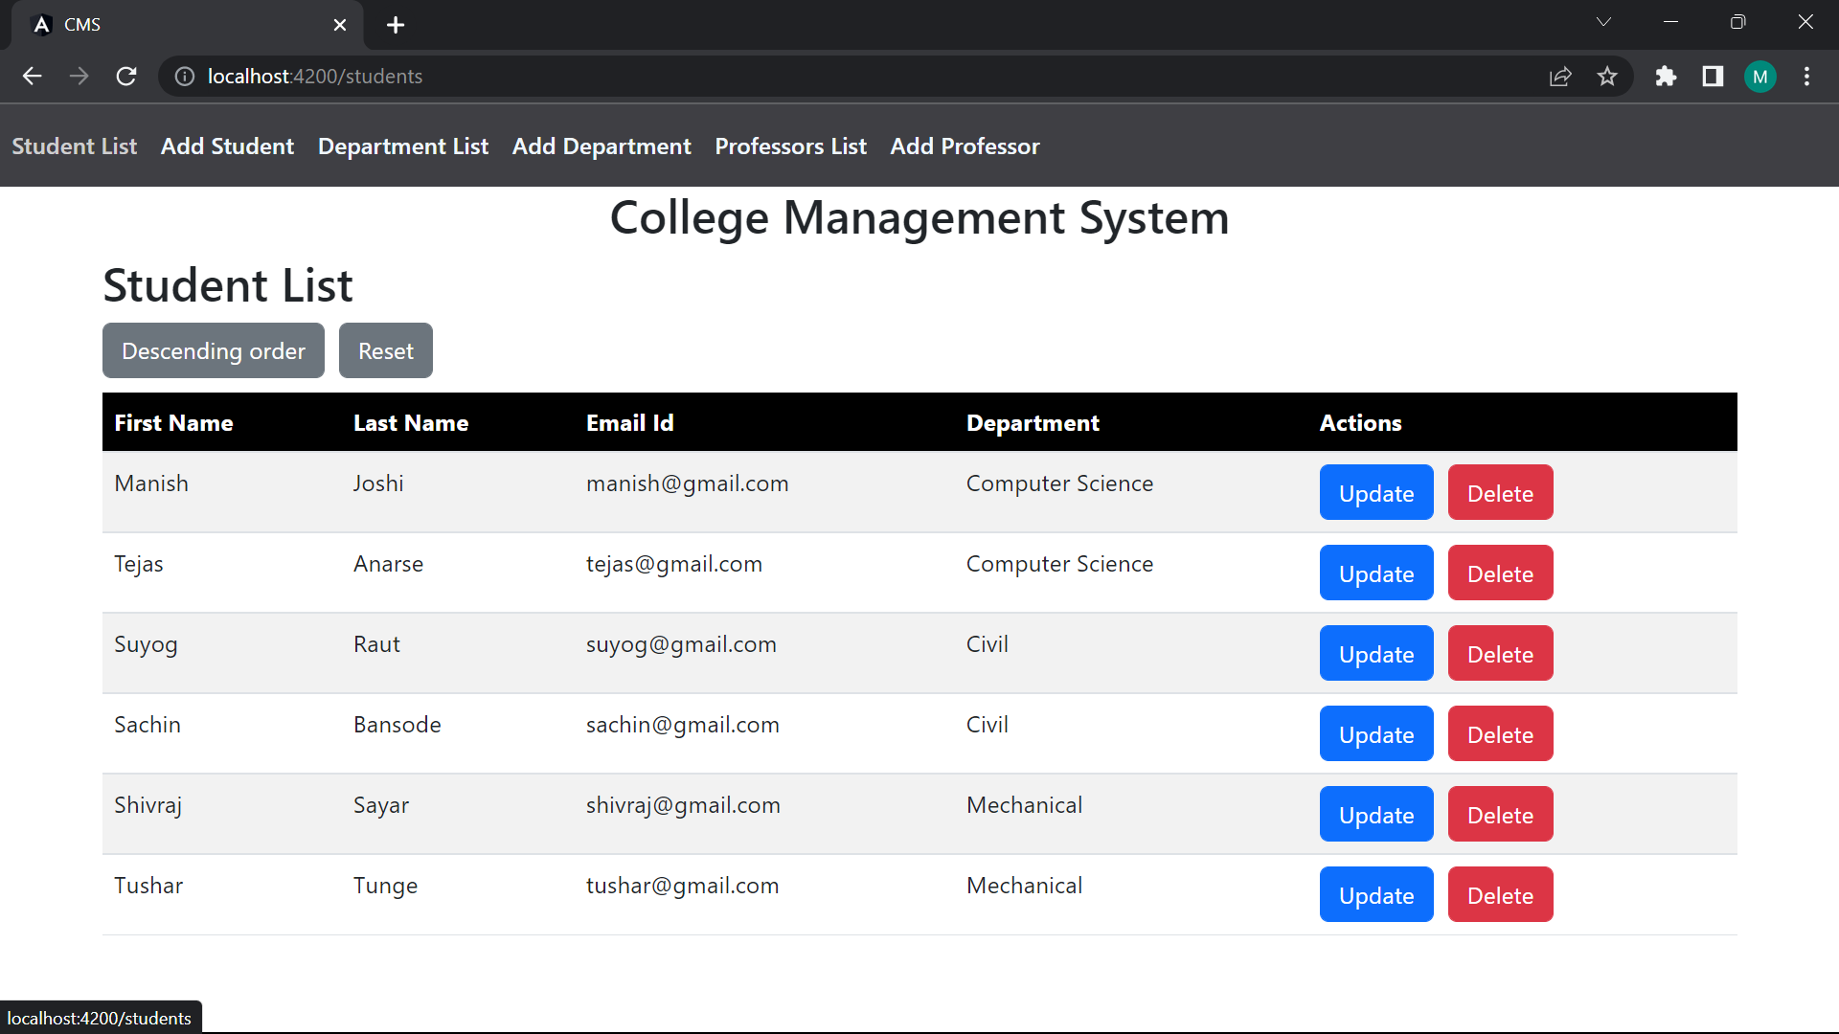
OUTPUT SCREENSHOTS
HOME PAGE

Slide 8
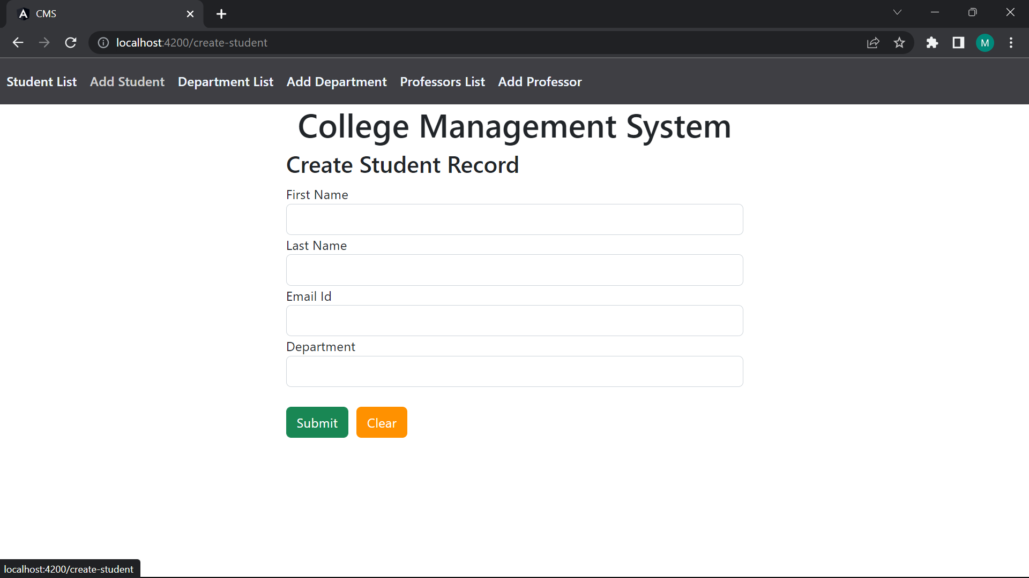

Slide 9
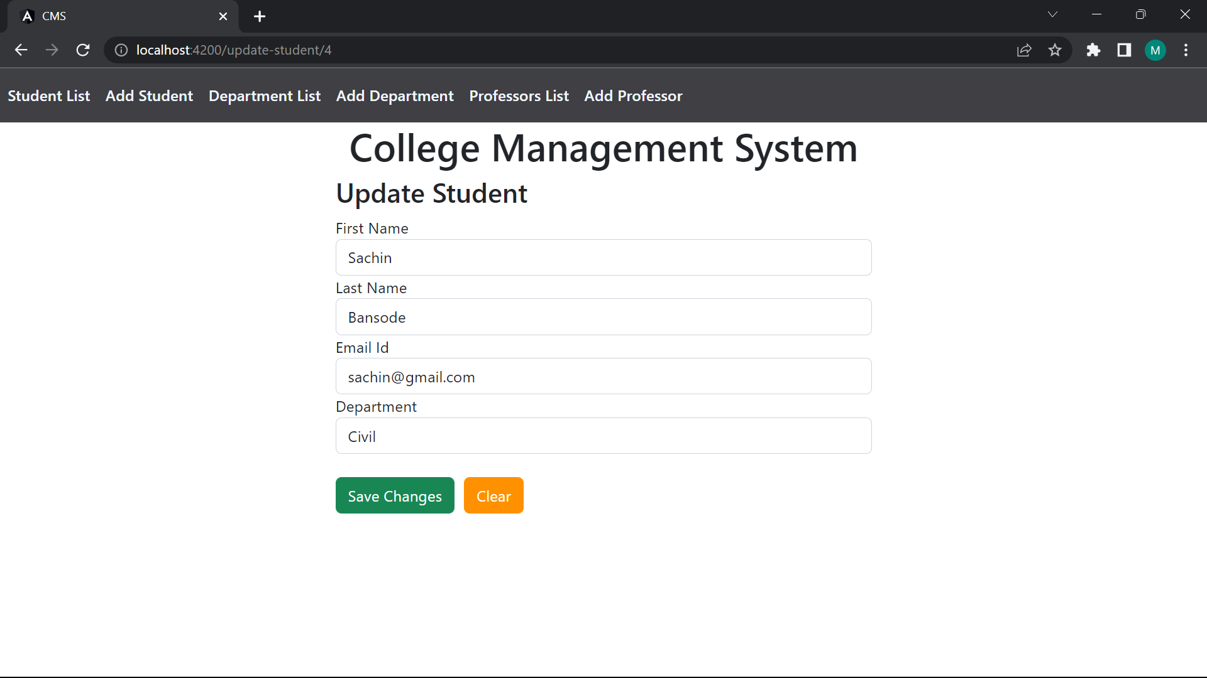

Slide 10
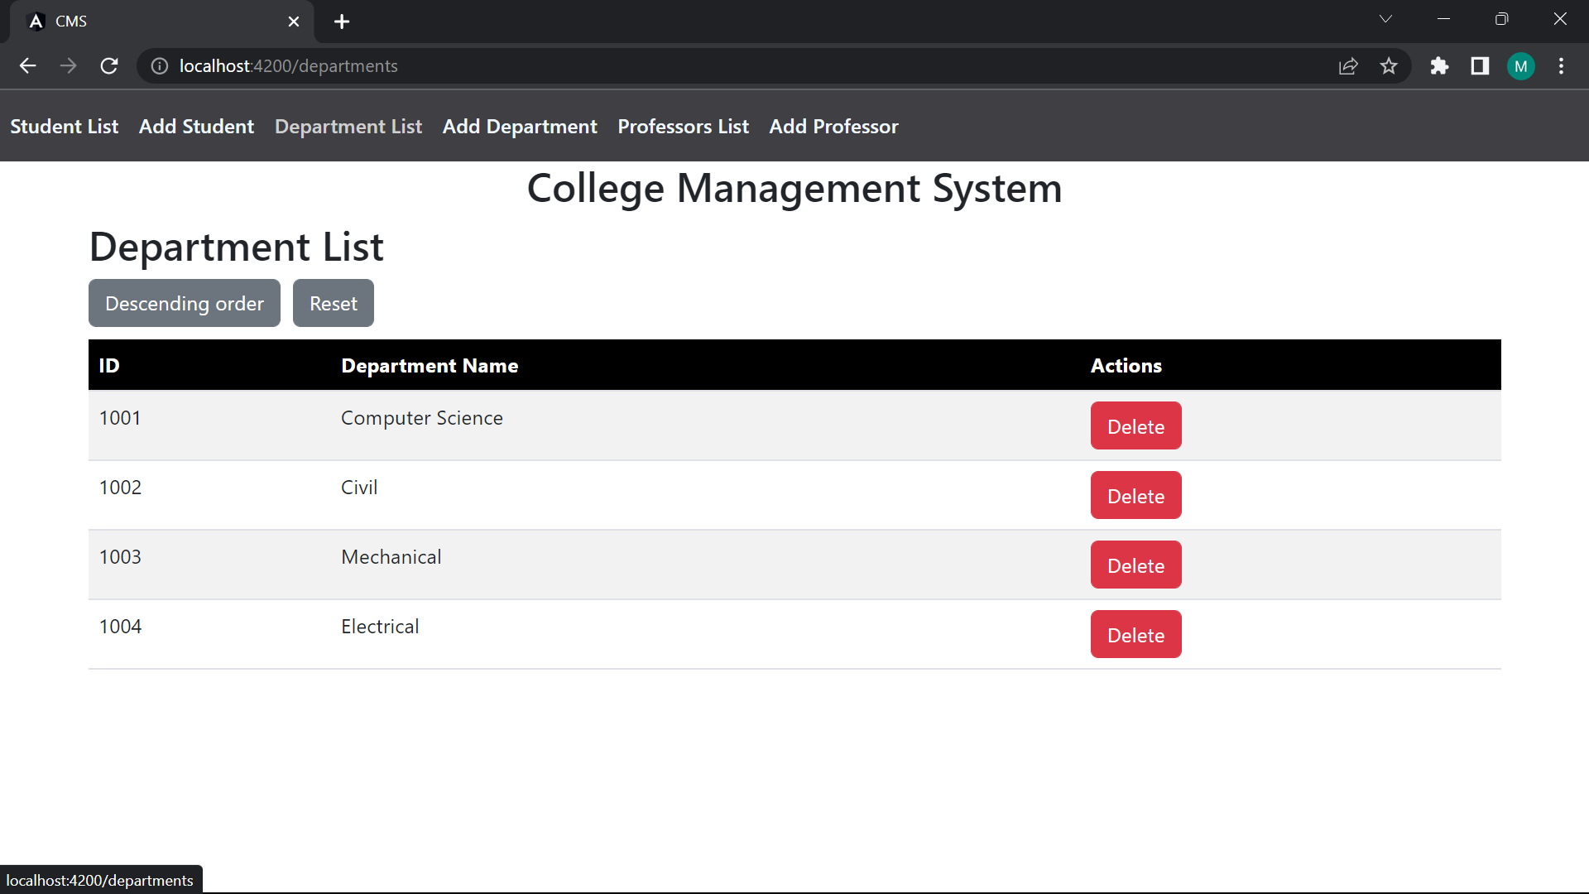

Slide 11
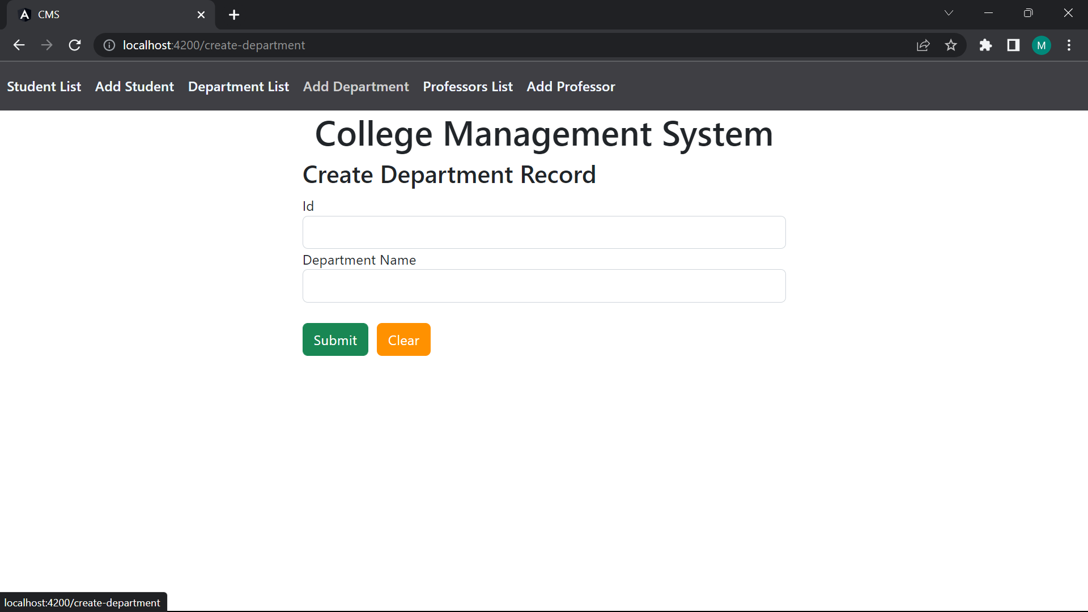

Slide 12
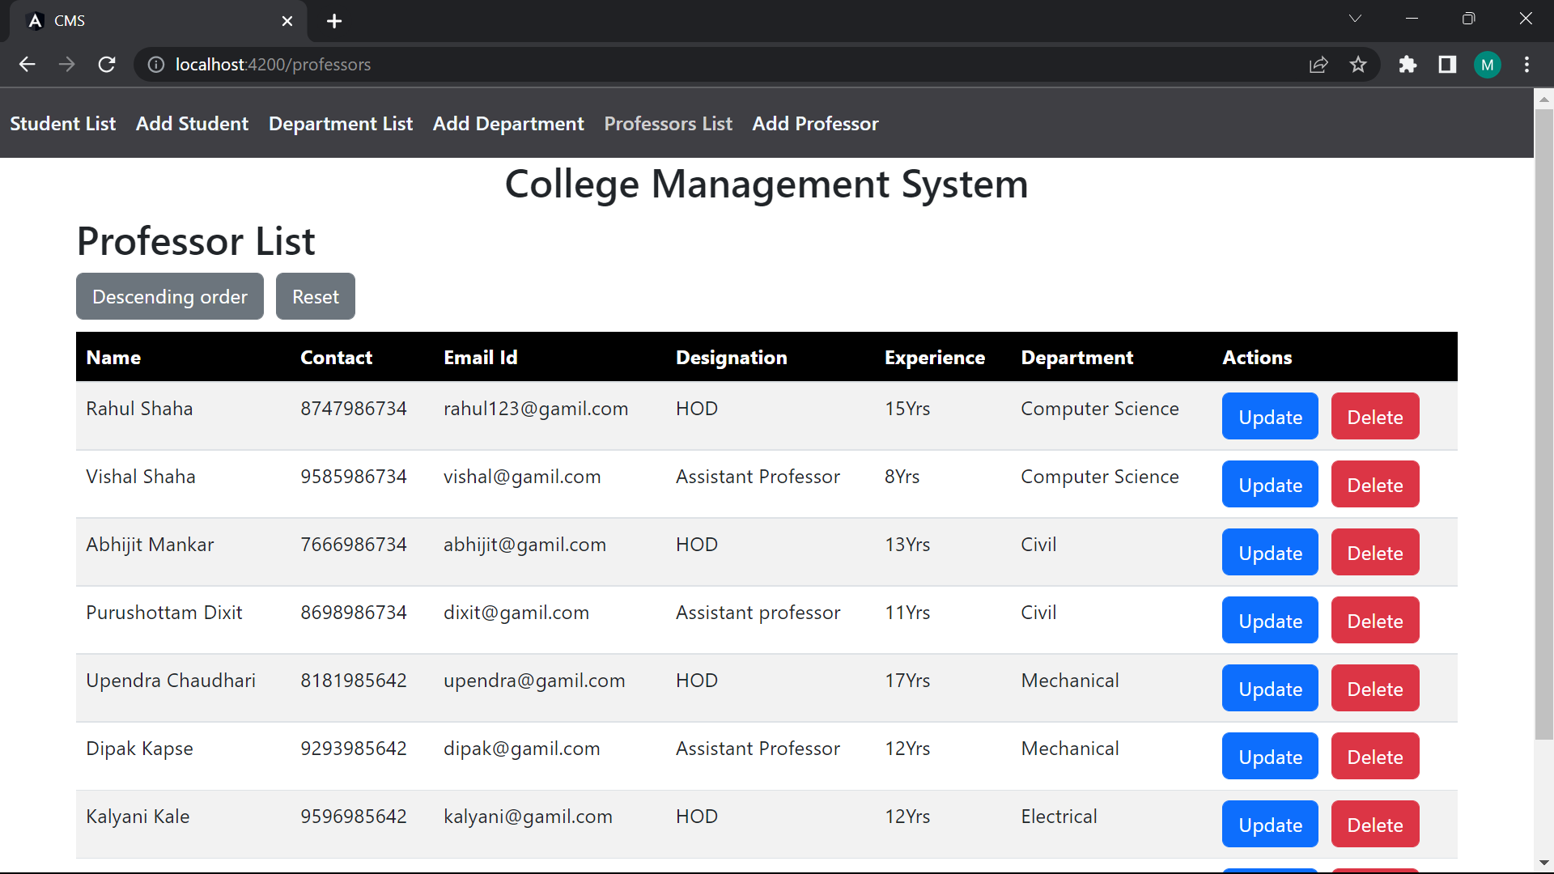

Slide 13
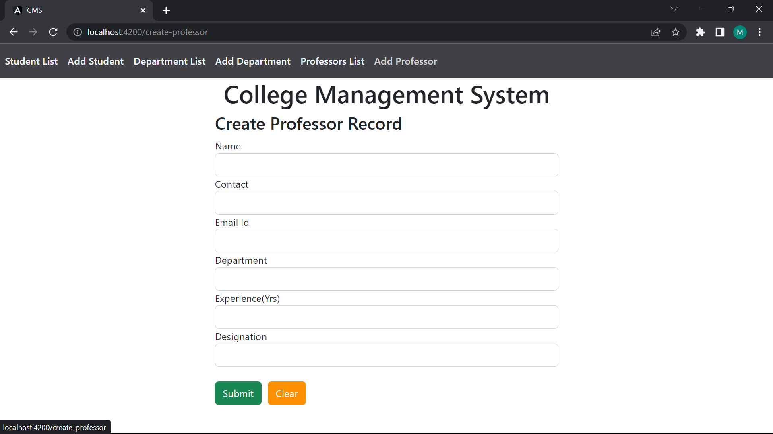

Slide 14
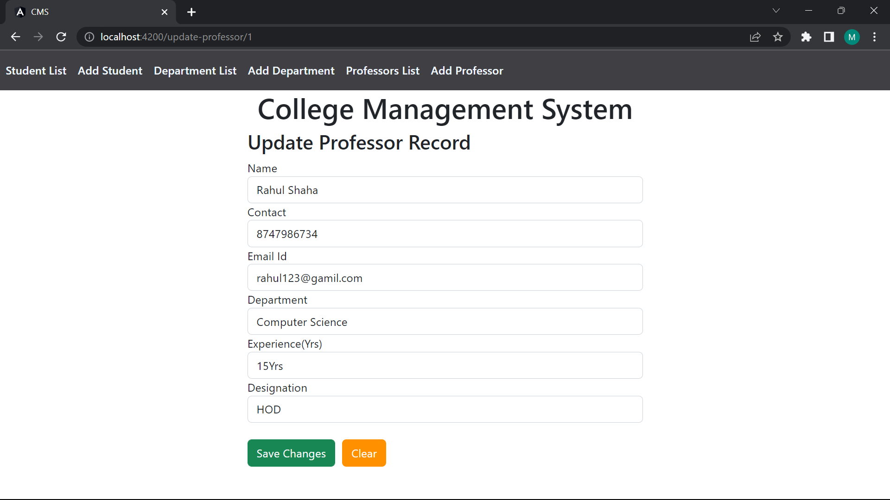

Slide 15
CONCLUSION
Our project is only a humble venture to satisfy the needs to manage their project work. Several user-friendly coding has also adopted. The objective of software planning is to provide a frame work that enables the manger to make reasonable estimates made within a limited time frame at the beginning of the software project and should be updated regularly as the project progresses.
At the end it is concluded that we have made effort on following points
We understand the problem domain and produce a model of the system, which describes operations that can be performed on the system.
We included features and operations in detail, including screen layouts.
We designed user interface and security issues related to system.
Finally, the system is implemented and tested according to test cases.

Slide 16
THANK YOU

